Slide 1
Online Shopping System
Capstone Project – Review II
Database Implementation
Database Management Systems (2501IT05)
P. KRISHNA KUMARI - 25B11AI863
P. MADHU SHALINI - 25B11AI957
S. TEJASWINI - 25B11AIB52
T. DEVI PHANITHA – 25B11AIB84

Slide 2
1. Project Overview
Centralized relational database for managing online shopping activities.
Core entities: Customer, Product, Category, Cart, Order, Order Item, and Payment.
Stores customer details, product information, prices, stock levels, and order history.
Supports product browsing, customer registration, cart management, and order placement.
Records payment details and tracks payment and order status.
Updates product inventory when orders are placed or cancelled.
Uses primary and foreign keys to connect related records.
Applies normalization to reduce duplicate data and improve consistency.
2

Slide 3
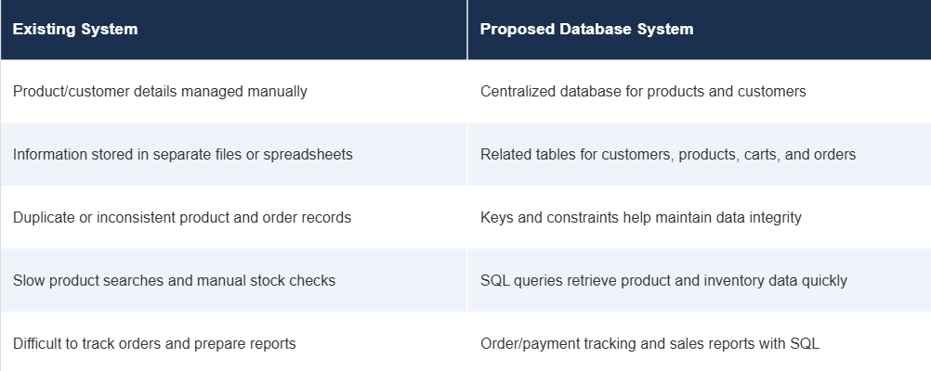
2. Existing System and Proposed System
3

Slide 4
3. Functional Requirements
Customer Management – add, update, search, and display customer details.
Product Management – maintain product names, descriptions, prices, categories, and stock quantities.
Category Management – organize products into categories and maintain category information.
Cart Management – add, update, and remove products in a customer’s shopping cart.
Order Management – place orders and maintain order items, quantities, totals, and order status.
Payment Management – record payment details and track payment status for each order.
Inventory Management – monitor product stock and update quantities when orders are placed or cancelled.
Search and Reporting – retrieve product, customer, order, sales, and inventory information using SQL queries.
4

Slide 5
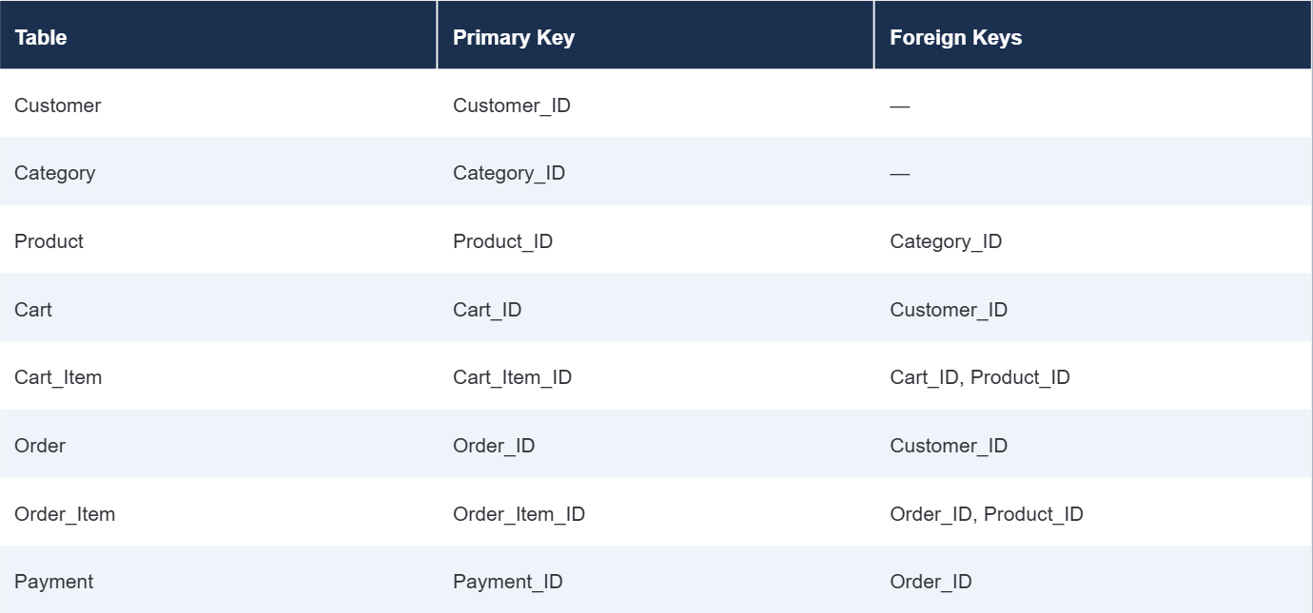
4. Database Schema Used for Implementation
5

Slide 6
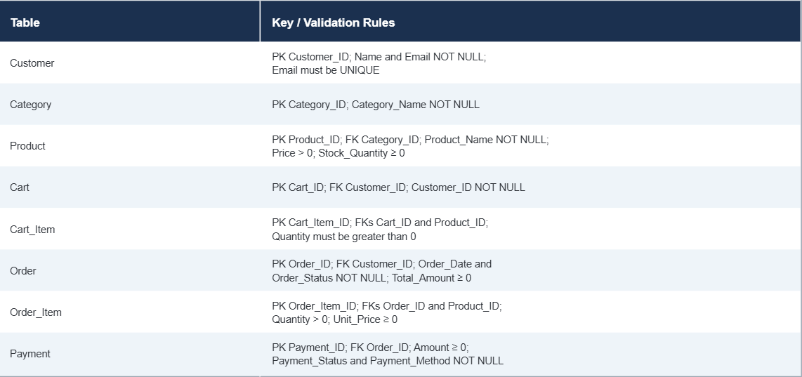
5. Table Design and Constraints
6

Slide 7
6. Normalization up to 3NF
UNF: Repeated product, category, customer, order, and payment information may occur in one record.
1NF: Repeating groups are removed; each field contains a single value, and each ordered product is stored as a separate order item.
2NF: Partial dependencies are removed by separating customer, product, order, and order-item information into related tables.
3NF: Transitive dependencies are removed; category, customer, and payment details are stored in their own relations.
Final relations: Customer, Category, Product, Cart, Cart_Item, Order, Order_Item, and Payment.
7

Slide 8
7. SQL Implementation – DDL
Create the online shopping database using the selected DBMS.
Create the tables: Customer, Category, Product, Cart, Cart_Item, Order, Order_Item, and Payment.
Define Primary Keys to uniquely identify records in each table.
Define Foreign Keys to link customers, products, carts, orders, and payments.
Apply NOT NULL, UNIQUE, CHECK, and DEFAULT constraints where appropriate.
Use ALTER TABLE to modify table definitions when needed.
Include the actual SQL statements and their execution results in the final presentation.
8

Slide 9
8. SQL Implementation – DML
Insert realistic sample records into all tables: Customer, Category, Product, Cart, Cart_Item, Orders, Order_Item, and Payment.
Insert parent records before dependent records to satisfy foreign-key constraints.
Use UPDATE statements to demonstrate changes, such as updating product stock or order status.
Use DELETE statements to remove eligible records while respecting referential dependencies.
Include the SQL statements and execution results in the final presentation.
9

Slide 10
9. DQL – Data Retrieval
SELECT Product_Name, Price
FROM Product
WHERE Price < 1000
ORDER BY Price ASC;SELECT DISTINCT Category_Name
FROM Category;
SELECT Product_Name, Price
FROM Product
WHERE Product_Name LIKE '%wireless%’;
SELECT Name, Phone
FROM Customer
WHERE Phone IS NOT NULL;
10

Slide 11
10. SQL Queries – Joins
Customer–Order: Display customer names with their order details.
Product–Category: Display products with their category names.
Cart–Cart Item–Product: Display each customer’s cart items and product details.
Order–Order Item–Product: Display ordered products, quantities, and prices.
Customer Order Payment: Combine Customer, Orders, and Payment to display order and payment details.
11

Slide 12
11. SQL Queries – Aggregate Functions
COUNT() – Count customers, products, or orders.
AVG() – Calculate the average product price or order value.
MAX() – Find the highest product price or largest order.
MIN() – Find the lowest product price or smallest order.
SUM() – Calculate total sales or total units sold.
GROUP BY – Summarize orders by customer or sales by product category.
HAVING – Filter grouped results, such as categories with sales above a chosen amount.
12

Slide 13
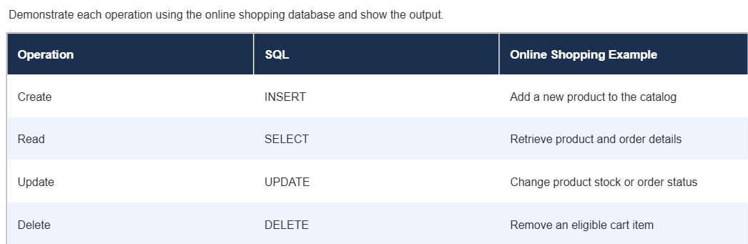
12. CRUD Operations
13

Slide 14
13. Views
Create views for frequently needed online shopping information.
Customer Orders View: Show customer name, order ID, order date, total amount, and order status.
Order Details View: Show order ID, product name, quantity, unit price, and subtotal.
Product Catalog View: Show product name, category, price, and stock availability.
Retrieve view data using SELECT statements.
Views simplify common queries, combine related table data, and provide consistent information for reports.
14

Slide 15
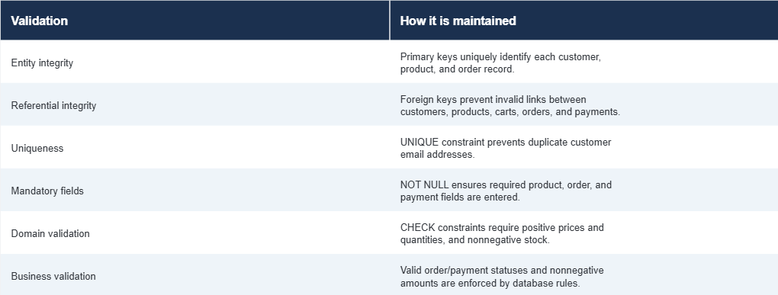
14. Data Integrity and Validation
15

Slide 16
15. SQL Output and Screenshots
Show screenshots of the online shopping database and its tables: Customer, Category, Product, Cart, Cart_Item, Orders, Order_Item, and Payment.
Show sample customer, category, product, cart, order, and payment records.
Include outputs for important DDL, DML, and DQL statements.
Add screenshots of customer order joins, sales aggregates, CRUD operations, and database views.
Show validation results, such as errors for duplicate customer emails or invalid product-category references.
Replace all documentation placeholders with actual screenshots from the online shopping database.
16

Slide 17
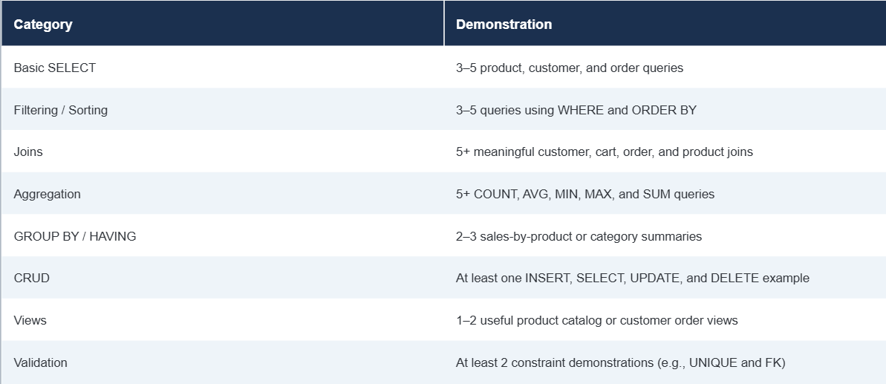
16. Query Coverage for Demonstration
17

Slide 18
17. Live Database Demonstration – Recommended Order
Open the online shopping database/schema.
Show the eight tables and their relationships: Customer, Category, Product, Cart, Cart_Item, Orders, Order_Item, and Payment.
Show table structures, primary keys, foreign keys, and constraints.
Display the inserted sample data.
Demonstrate DDL, DML, and DQL statements.
Demonstrate CRUD operations using shopping data.
Run joins and aggregate queries for orders, products, and sales.
Display a view, such as customer order details.
Demonstrate validation and data integrity constraints.
Explain normalization up to 3NF and answer questions.
18

Slide 19
18. Conclusion
The system organizes customer, product, category, cart, order, and payment information in a relational database.
Related tables connect shopping records and reduce data duplication.
Primary keys uniquely identify records, while foreign keys maintain relationships between tables.
Constraints help prevent invalid prices, quantities, and incomplete required information.
Normalization improves consistency by storing each type of information in the appropriate table.
SQL queries support product searches, inventory checks, order tracking, and payment lookups.
Joins combine related information, while aggregate functions help summarize sales and orders.
19

Slide 20
19. Future Enhancements
Role-based access for customers, administrators, and other authorized users.
Wishlist and product reviews so customers can save products and share feedback.
Shipping and delivery tracking with shipment status updates.
Discounts and promotions through coupons, offers, and loyalty points.
Inventory alerts to notify administrators when stock is low.
Sales dashboards and reports for tracking revenue, orders, and popular products.
Multiple payment options with secure payment processing.
Web or mobile application interface for convenient shopping across devices.
Database backup, recovery, audit logging, and stronger security to protect shopping data.
20

Slide 21
20. References
Silberschatz, A., Korth, H. F., and Sudarshan, S., Database System Concepts, McGraw Hill.
Elmasri, R. and Navathe, S. B., Fundamentals of Database Systems, 7th edition, Pearson. Pearson
Oracle, MySQL 8.4 Reference Manual. MySQL Documentation
Course lecture notes, laboratory exercises, and approved DBMS learning resources.
21

Slide 22
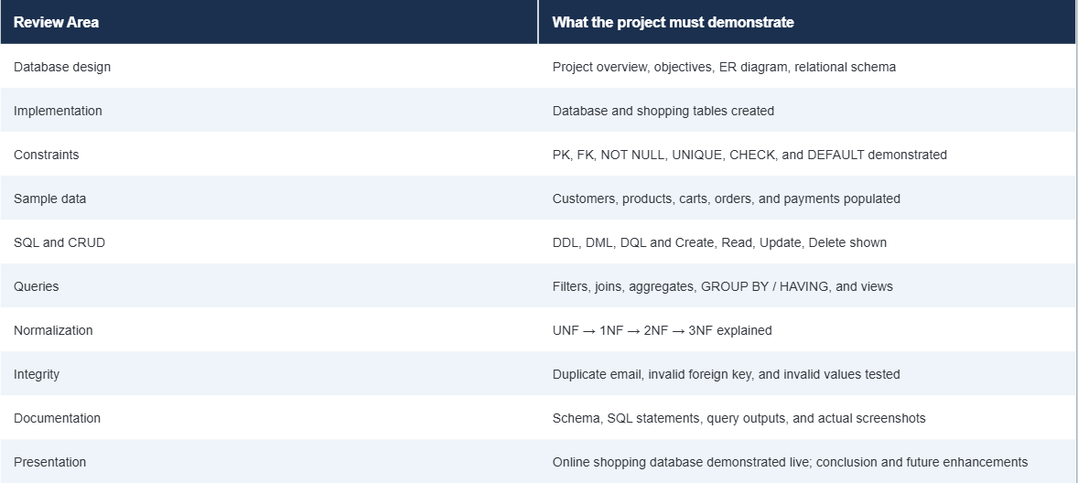
21. Final Review Checklist
22

